Slide 1

Department of Computer Science & Engineering
SIGN LANGUAGE TRANSLATOR FOR SPEECH-IMPAIRED
Date: 23 April 2021
SOMIREDDYGARI SAMIKSHA : 17WH1A0516
TURIYA DANDU : 17WH1A0536
THONDAPU NEELIMA CHOWDARY : 17WH1A0545
Internal Guide: Mrs. Naga Kalyani.Ayyadevara
Designation : Assistant Professor
BVRIT HYDERABAD College of Engineering for Women

Slide 2
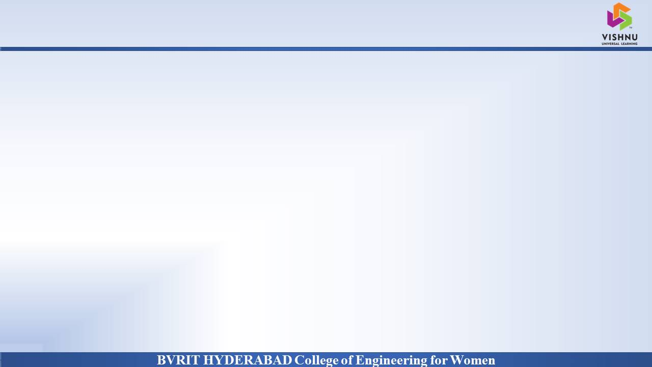
Why Should I Study this course?
Abstract
PROBLEM STATEMENT
Examples
Create Computer application and train a model when shown a real time video of the hand gestures of American Sign Language. Shows output for particular sign in text format on screen.
PROBLEM OBJECTIVE
Although a certain fraction of the world suffers from speech and hearing disabilities, Sign Language is not a wide spread language across the world.
Therefore, to aid with a smoother communication between speaking and non-speaking world, technical development can be introduced. This project proposes an application for it.
BVRIT HYDERABAD College of Engineering for Women

Slide 3
Architecture
Data acquisition
Data PreProcessing
Building a deep learning model based on CNN
Class Recognition
BVRIT HYDERABAD College of Engineering for Women

Slide 4
Technology Stack
Python Language
Machine learning
CNN
Packages & Libraries
Numpy, os, cv2
Tensorflow
Matplotlib
BVRIT HYDERABAD College of Engineering for Women

Slide 5

SYSTEM SPECIFICATIONS
ENVIRONMENT | SPECIFICATIONS
HARDWARE | Processor - Intel Core i5 Memory(RAM) - 8GB Storage - 1TB
SOFTWARE | Python(tensorflow) OS- Windows 10 Anaconda Navigator
BVRIT HYDERABAD College of Engineering for Women

Slide 6
CNN
What is CNN
Image analysis
Why CNN over traditional networks
Layers in CNN
BVRIT HYDERABAD College of Engineering for Women

Slide 7
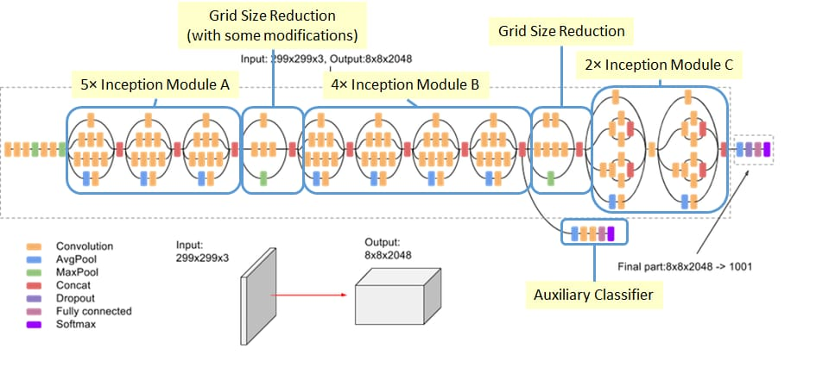
Inception V3
BVRIT HYDERABAD College of Engineering for Women

Slide 8
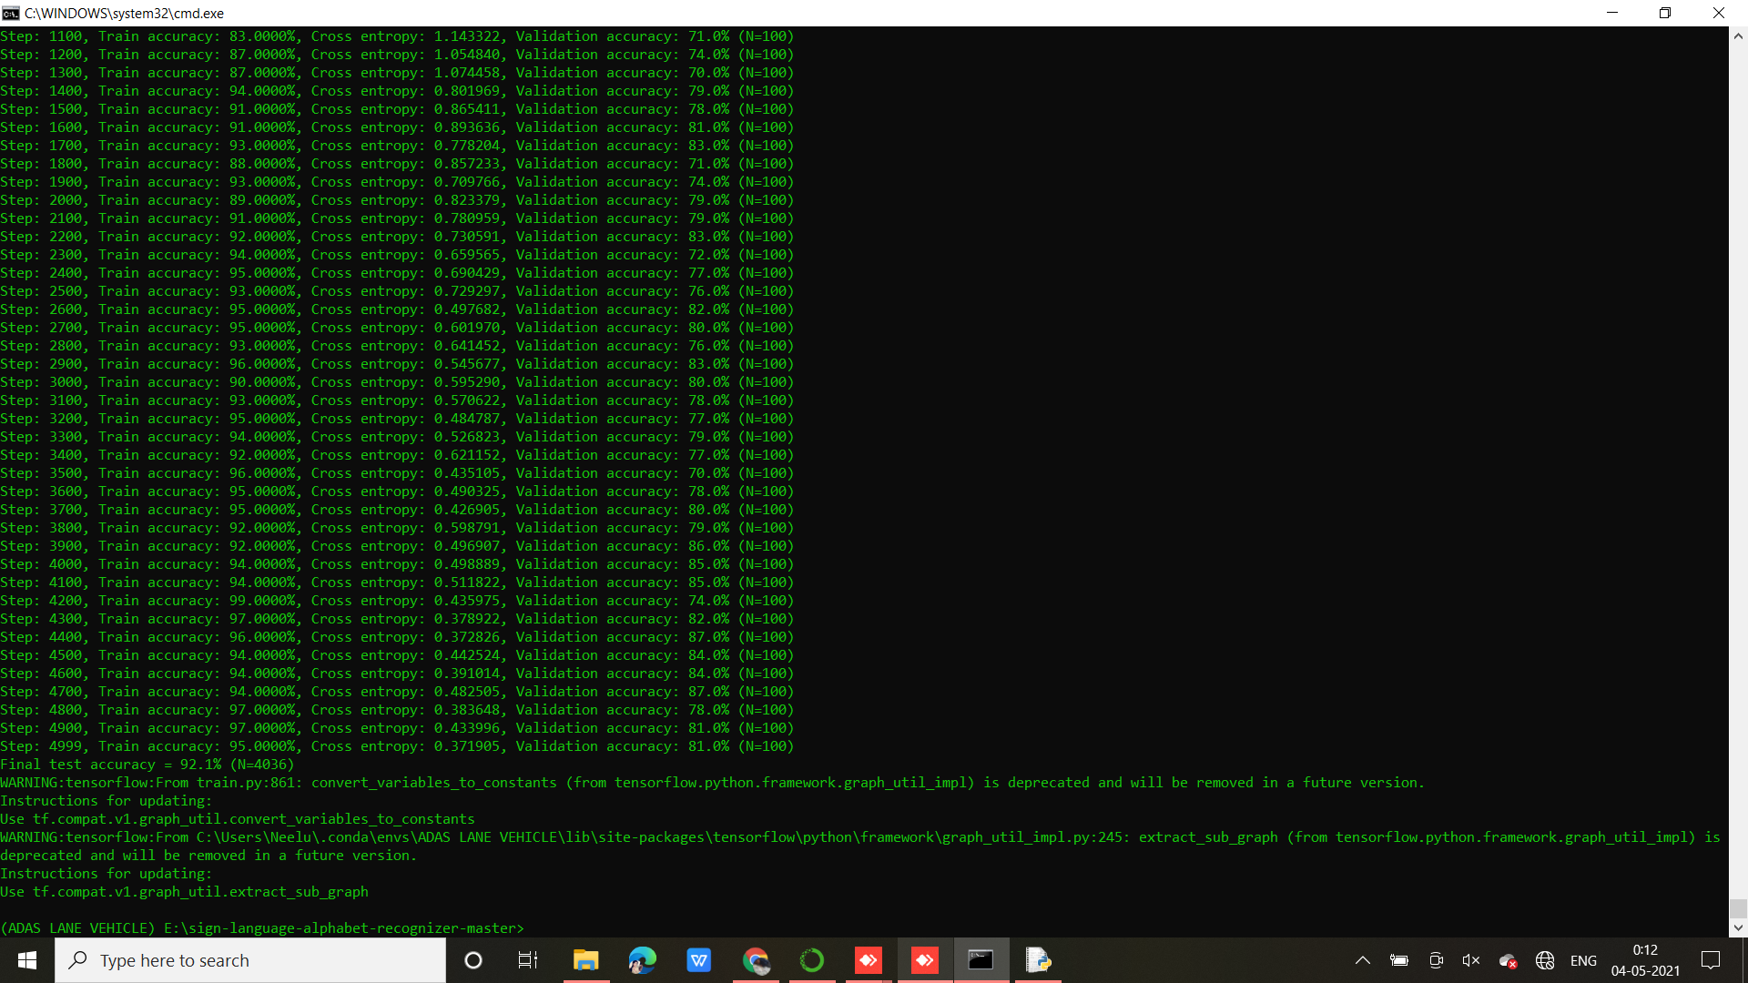
Output
BVRIT HYDERABAD College of Engineering for Women

Slide 9
TimeLine
 | Identifying Business Case Requrements & Specifications
 | Data Gathering
 | Data PreProcessing & Training
 | Data Prediction Project Report
Review 0
Review 1
Review 2
Review 3
BVRIT HYDERABAD College of Engineering for Women

Slide 10
References
Base Paper:
https://ieeexplore.ieee.org/document/9225422
Convolutional Neural Network:
https://medium.com/nybles/a-brief-guide-to-convolutional-neural-network-cnn-642f47e88ed4
Data Set:
https://www.kaggle.com/grassknoted/asl-alphabet
BVRIT HYDERABAD College of Engineering for Women

Slide 11
Thank you
BVRIT HYDERABAD College of Engineering for Women

